Slide 1

E-Commerce Book-Store
B.E Computer IV Project

Slide 2

Group Members
Laxmi Prasad Bhusal
Rabin Chalise
Saiman Pokhrel
Ujjwal Bhusal
Sandesh Sharma

Slide 3

Special Thanks
United Technical College Bharatpur, Chitwan
Principle Prof. Keshav Awasthi
HOD Er Sulav Adhikari
Supervisor Er Bikal Baral
Supervisor Er Ramji Subedi

Slide 4

Contents
Introduction
Objective
Requirement
Scopes
Screenshots
Page 1 : Home
Page 2 : About
Page 3 : Shop
Page 4 : Contact
Page 5 : Admin Panel
Advantage
Limitations
Conclusion

Slide 5

Introdution
Online Book store is an online web application where the customer can purchase books online. Through a web browser the customers can search for a book by its title , later can add to the shopping cart and finally purchase the book. The user can login using his account details or new customers can set up an account very quickly. They should give the details of their name, contact number and shipping address.
This application is developed using HTML, CSS, Java Script , PHP and MYSQL programming language.

Slide 6

Objective
The main objective of “E-Commerce Book-Store” is to provide the essence of an online book store via a simple yet powerful website.
An Admin Can Upload the book details and customers can buy the desired books from the website.

Slide 7
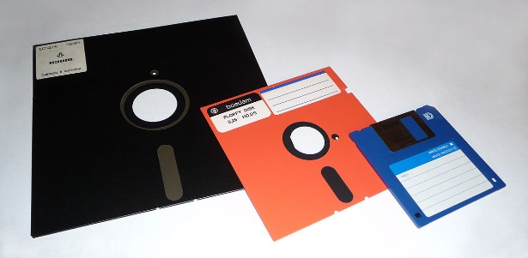
Software Requirements
Front End
HTML
CSS
Java Script
Back End
PHP
MYSQL
XAMPP

Slide 8
Scope
To provide users to purchase books online.
To provide a wide collection of book ranges.
To Provide a greater user interface experience.
To add and delete the product and price dynamically.
To send the message to the admin by the customers.

Slide 9
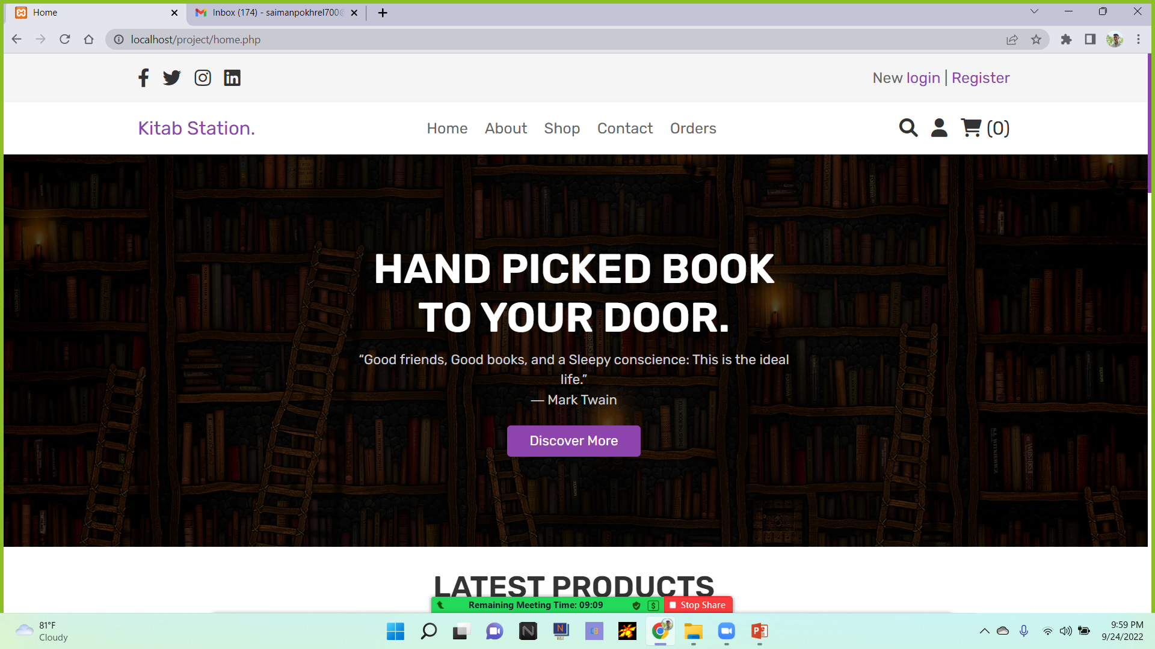
Home Page

Slide 10
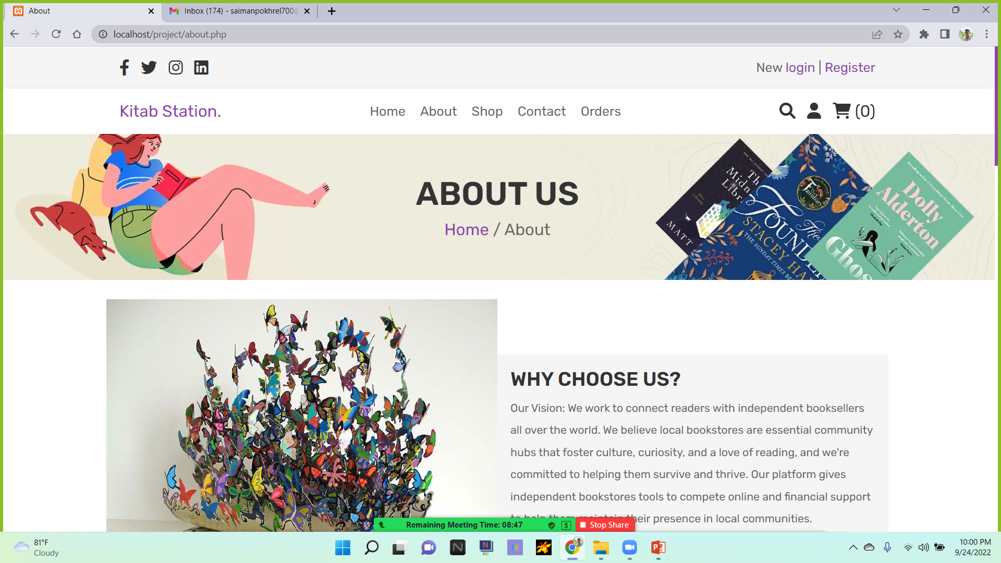
About Page

Slide 11
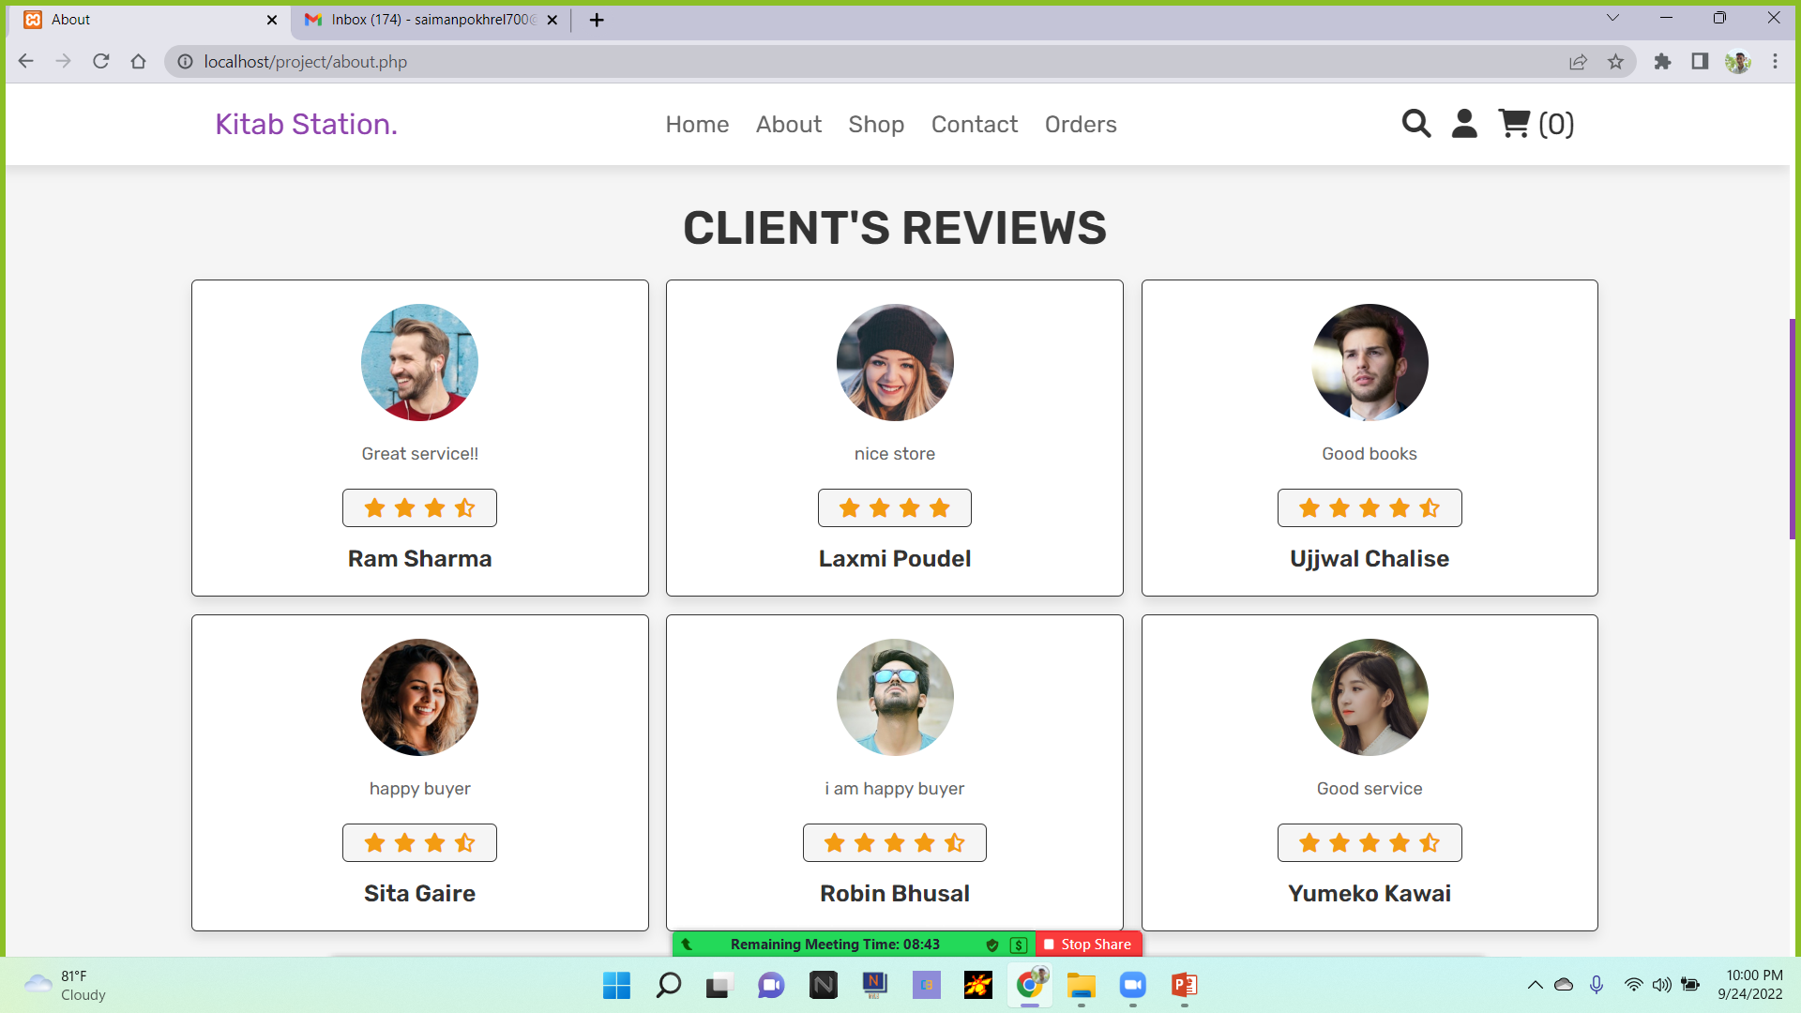

Slide 12
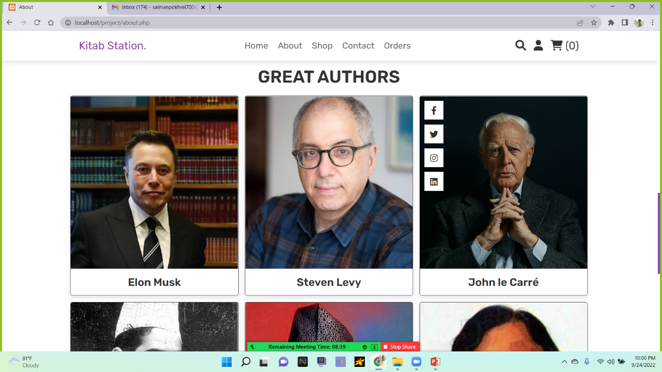

Slide 13
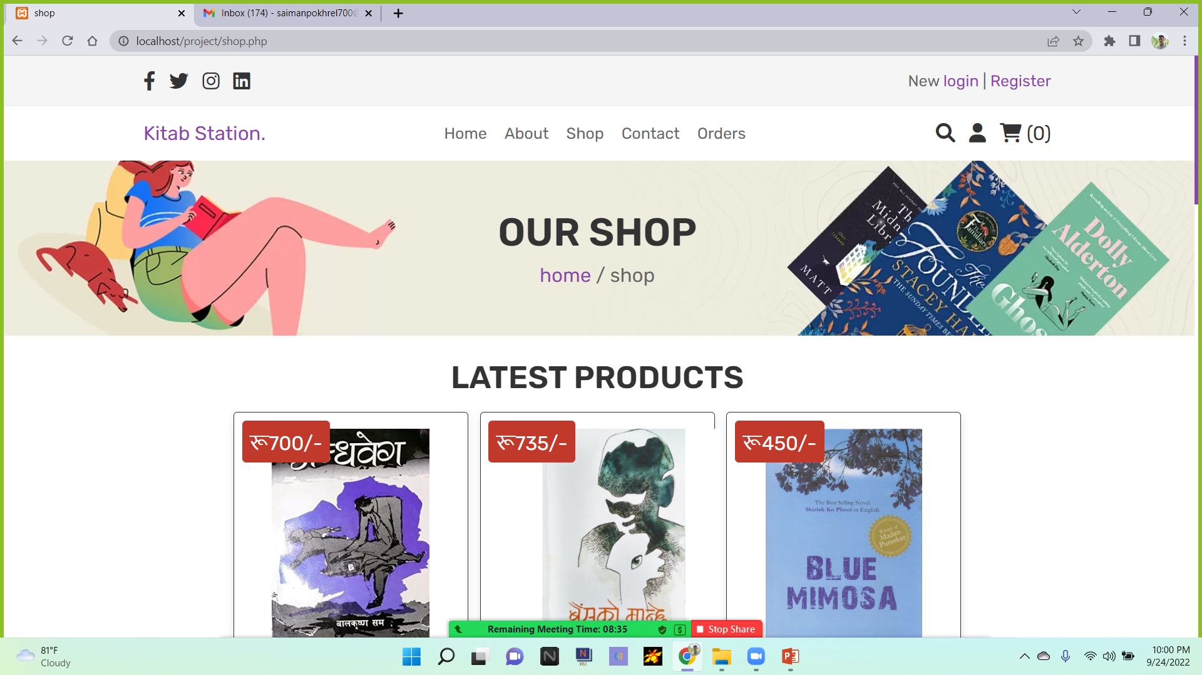
Shop

Slide 14
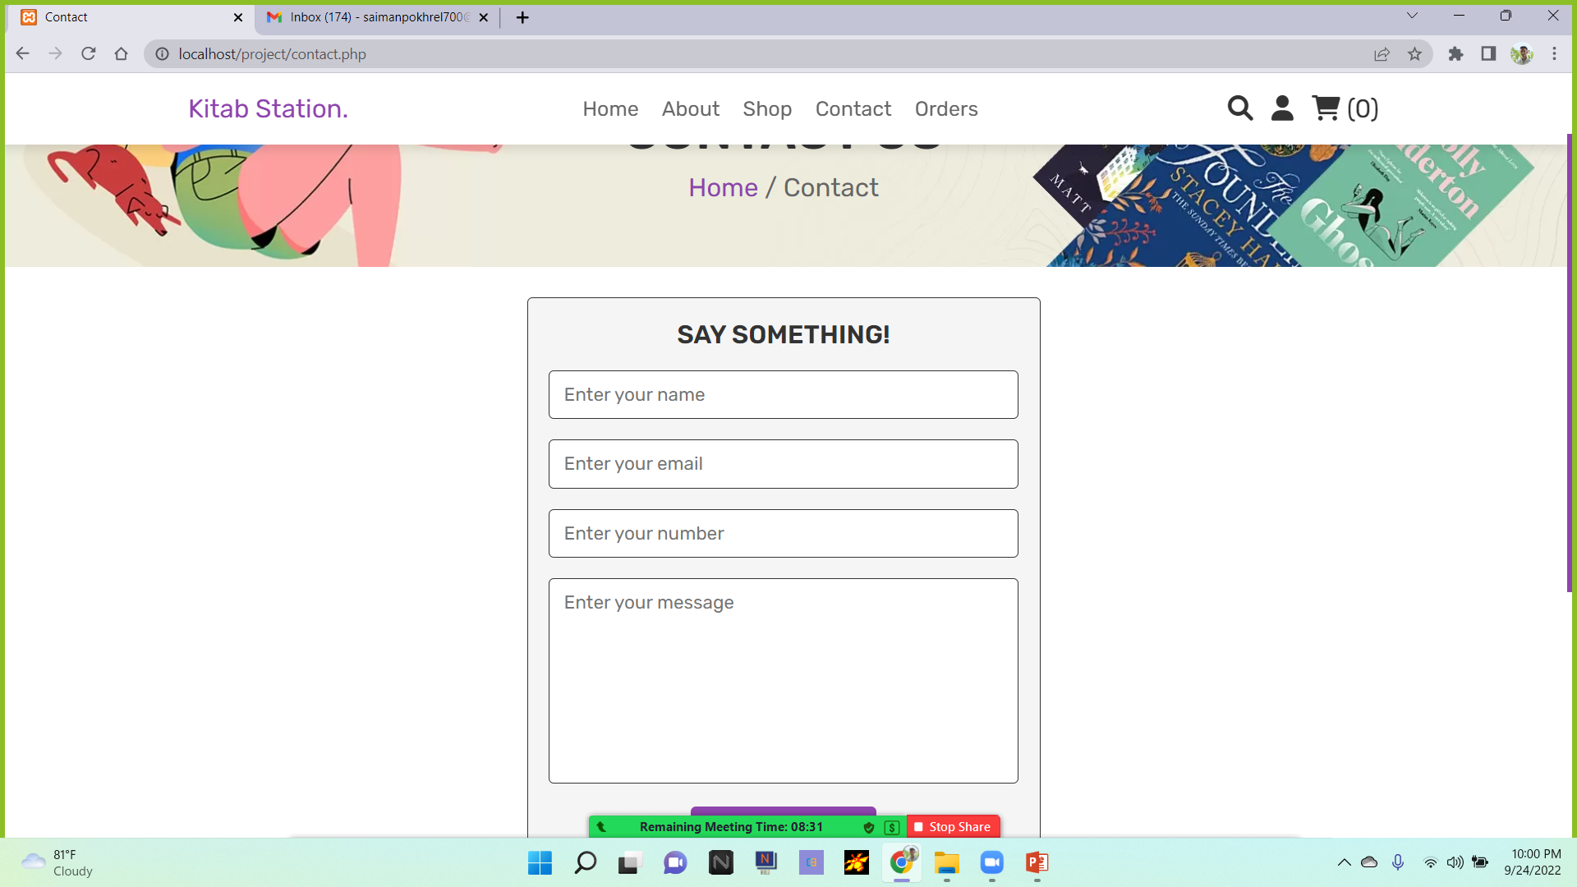
Contact

Slide 15
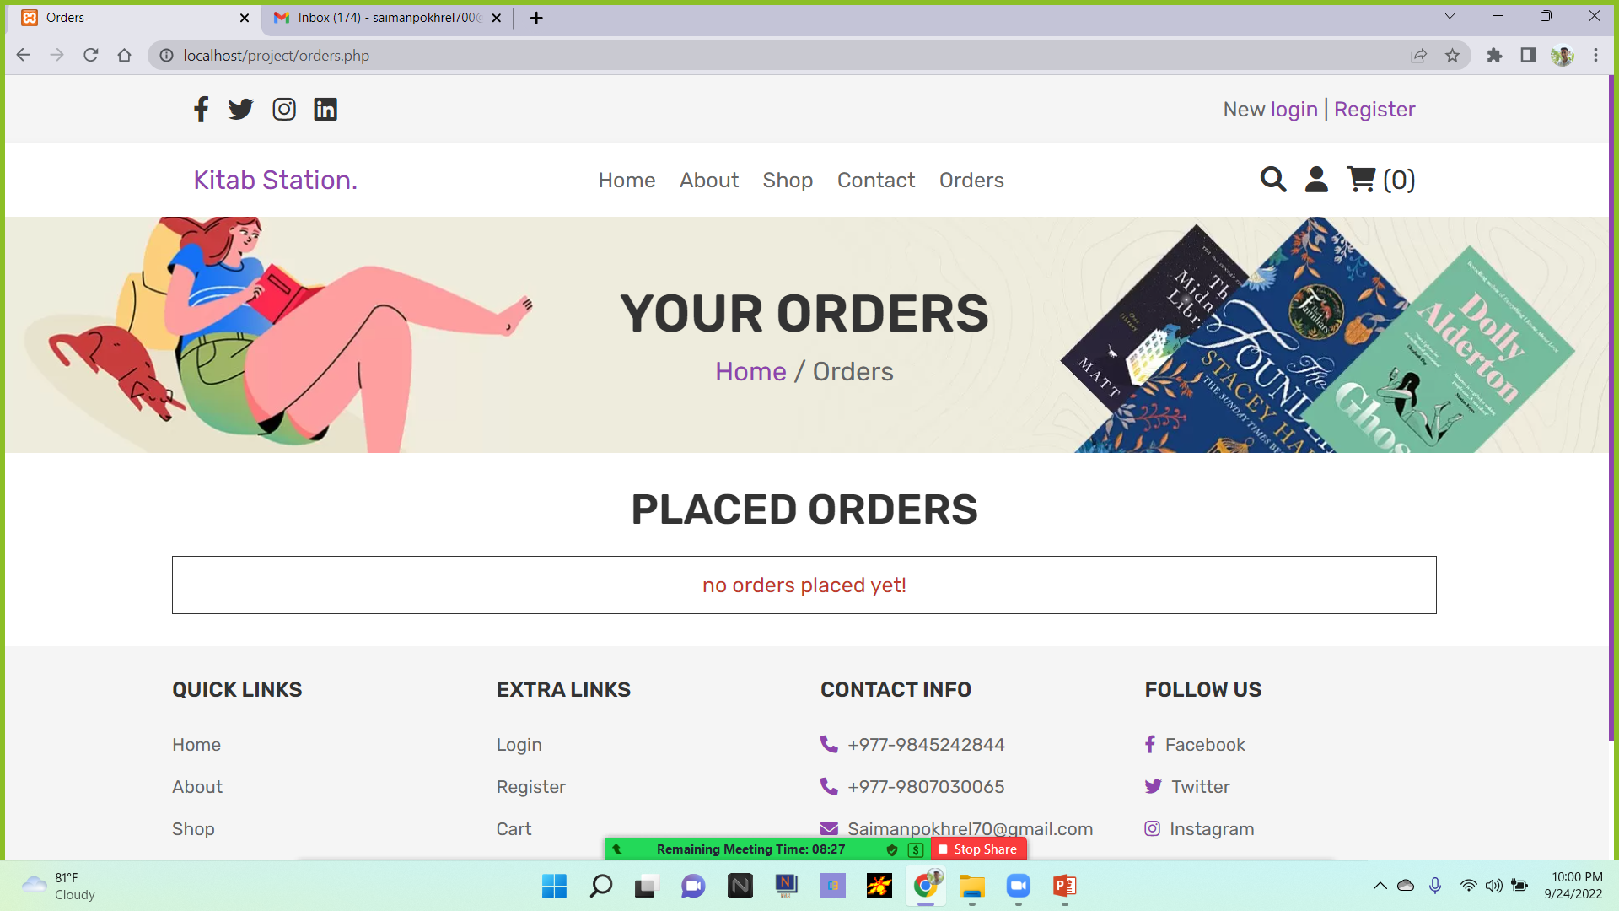
Order

Slide 16
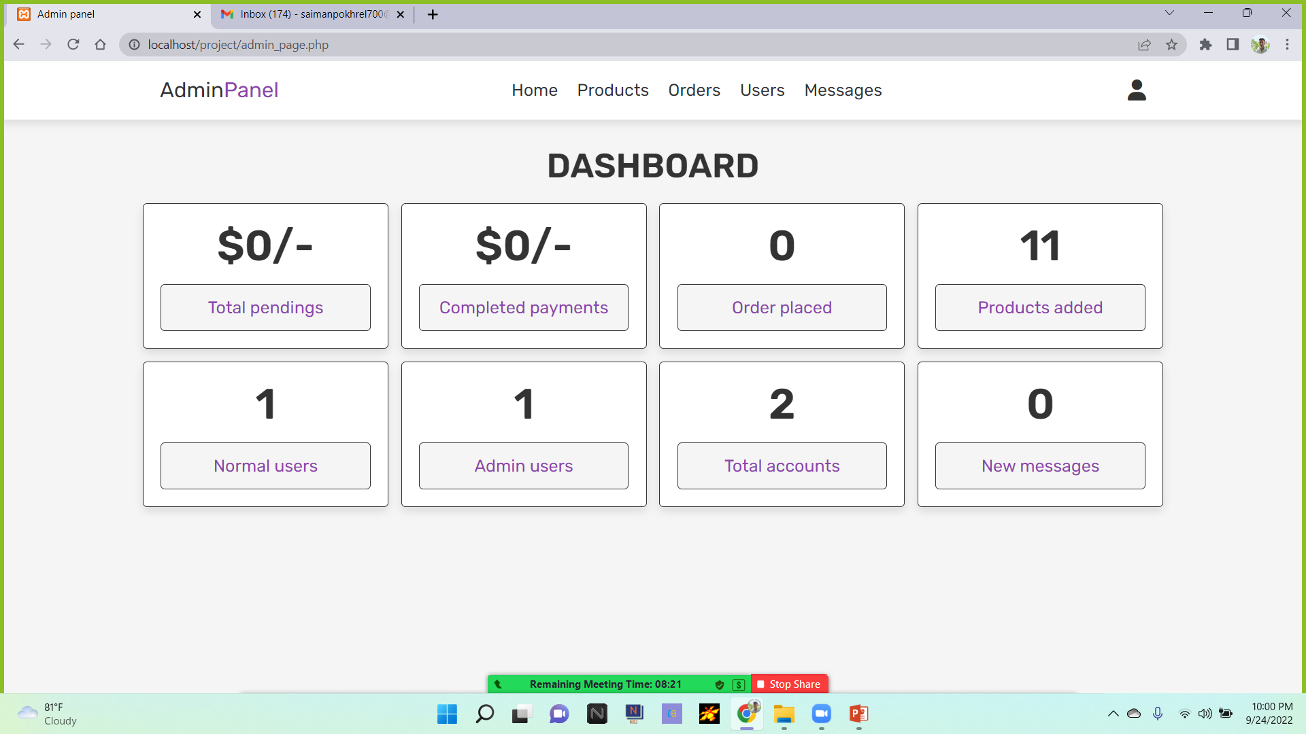
Admin Panel

Slide 17
Advantages
Buying and selling 24/7.
More reach to customers as there is no theoretical and geographical limitations.
Faster buying and selling procedure as well as easy to find products.
Low operational costs and easy to manage.

Slide 18
Limitations
Unable to examine products personally.
Not everyone is connected to internet.
Mechanical failures can cause unpredictable effects on the total process.
Payment gateway should be integrated.
Delivery feature is to be added.
Dynamic review is to be added.

Slide 19
Conclusions
“E-commerce book store” is an online website applications where the customers can purchase books through a web browser the customers can search for a book by its title or author, later can add to the shopping cart and finally purchase the books.

Slide 20


